Slide 1
Introduction to Image Processing
Lecture 1
Dr Muhammad Zubair

Slide 2
Text Book (s)
Gonzalez, R. C. and Woods, R. E., Digital Image Processing, 4th Edition, Pearson-Prentice Hall, Inc.
Gonzalez, R. C., Woods, R. E., and Eddins, S. L., Digital Image Processing Using MATLAB®, Pearson-Prentice Hall, Inc.

Slide 3
What is an Image?
Image is a source of information according to information theory
An image may be defined as a two dimensional function f(x,y) where x and y are spatial coordinates,
Amplitude of f at any pair of coordinates (x,y) is called the intensity or Gray level of the image at that point.

Slide 4
WHY IMAGE PROCESSING?
A picture is worth 1000 words.
The future is multimedia information processing
Images (and video) are everywhere!
Many and diverse applications
  – Astronomy, biology, geology, geography, medicine, law enforcement, defense, industrial inspection,…
Different imaging modalities: visual, x-ray, ultrasound,…
A video is worth 1000 sentences?

Slide 5
Importance of an image
A picture is worth a thousand words

Slide 6

What emotion comes into your mind by merely seeing this image?

Slide 7


Slide 8


Slide 9


Slide 10
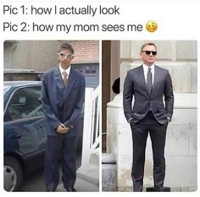

Slide 11
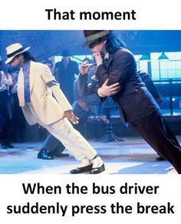

Slide 12
Digital Image
When x,y and the amplitude values of f are all finite, discrete quantities, we call the image a Digital Image.
A digital Image is composed of a finite number of elements each of which has a particular location and value
These elements are referred to as Picture Elements, Image Elements, Pels or Pixels.

Slide 13
Pixel
In digital imaging, a pixel is the smallest piece of information in an image.
Pixels are normally arranged in a regular 2-dimensional grid, and are often represented using dots or squares
The intensity of each pixel is variable; in color systems, each pixel has typically three or four components such as red, green, and blue, or cyan, magenta, yellow, and black

Slide 14
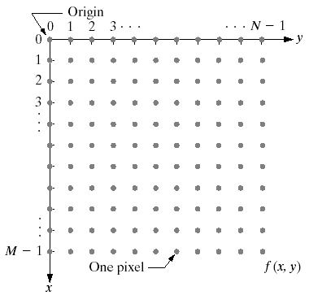
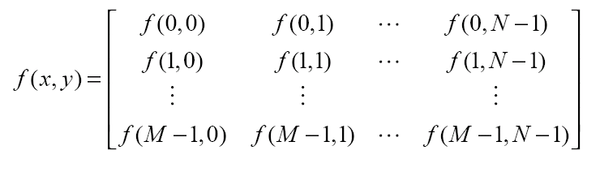
DIGITAL IMAGE REPRESENTATION
AN IMAGE IS A FUNCTION DEFINED ON A 2D COORDINATE f(x,y).
The value of f(x,y) is the intensity.
A digital image can be represented as a matrix.

Slide 15
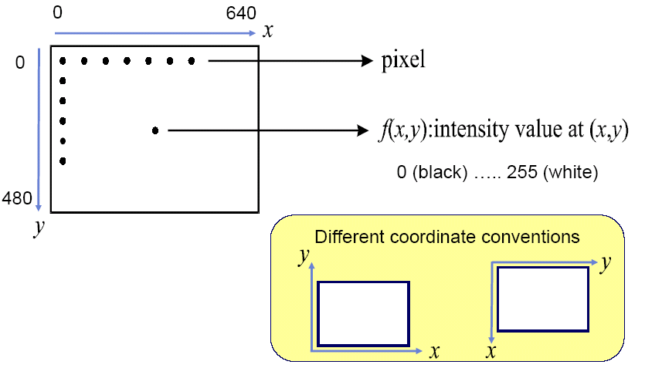
EXAMPLE
e.g. 640 x 480 8-bit image
DIP Lecs By Dr M.Almas Anjum College of E&ME

Slide 16
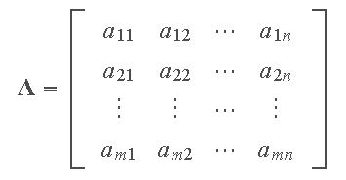
Basic Concepts of Matrices
An m×n (read "m by n") or (“m cross n”) matrix, denoted by A, is a rectangular array of entries or elements (numbers, or symbols representing numbers) enclosed typically by square brackets, where m is the number of rows and n the number of columns.

Slide 17
Basic Concepts of Matrices
A is square if m= n.
A is diagonal if all off-diagonal elements are 0, and not all diagonal elements are 0.
In diagonal matrix the entries outside the main diagonal (↘) are all zero. The diagonal entries themselves may or may not be zero.
For example, the following matrix is diagonal:
      [1 0 0; 0 4 0; 0 0 -3]

Slide 18
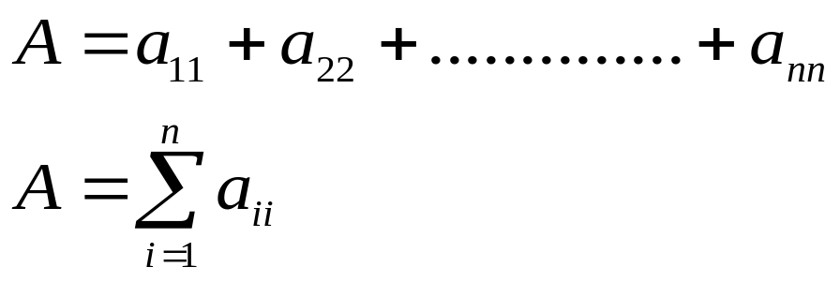
Basic Concepts of Matrices
A is the identity matrix ( I ) if it is diagonal and all diagonal elements are 1.
A is the zero or null matrix ( 0 ) if all its elements are 0.
The trace of A equals the sum of the elements along its main diagonal.
In linear algebra, the trace of an n-by-n square matrix A is defined to be the sum of the elements on the main diagonal (the diagonal from the upper left to the lower right) of A, i.e.,

Slide 19

Basic Concepts of Matrices
Two matrices A and B are equal if they have the same number of rows and columns, and a_{ij} = b_{ij} .
The transpose of an m×n matrix A is an n×m matrix obtained by interchanging the rows and columns of A.
A square matrix for which = A is said to be symmetric.

Slide 20
Basic Concepts of Matrices
Any matrix X for which XA=I and AX=I is called the inverse of A.
Let c be a real or complex number (called a scalar). The scalar multiple of c and matrix A, denoted cA, is obtained by multiplying every elements of A by c. If c = −1, the scalar multiple is called the negative of A.

Slide 21
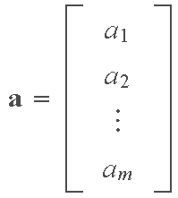


Basic Concepts of Matrices
A column vector is an m × 1 matrix:
A row vector is a 1 × n matrix:
A column vector can be expressed as a row vector by using
the transpose:

Slide 22

Basic Concepts of Matrices
The sum of two matrices A and B (of equal dimension), denoted A + B, is the matrix with elements a_{ij} + b_{ij}.
The difference of two matrices, A− B, has elements a_{ij} − b_{ij}.
The product, AB, of m×n matrix A and p×q matrix B, is an m×q matrix C whose (i,j)-th element is formed by multiplying the entries across the ith row of A times the entries down the jth column of B; that is,

Slide 23
Why do we Process Images?
Facilitate picture storage and transmission
Enhance and restore images
Extract information from images
Prepare for display or Printing

Slide 24
Digital Image Processing (DIP)
DIP refers to processing of digital images by means of Digital computers
Two principal application
  Improvement of pictorial info
    For human interpretation
  Processing of image data
    Storage
    Transmission
    Representation for machine perception and processing

Slide 25
Key Stages in Digital Image Processing
Image
Restoration
Morphological Processing
Image Enhancement
Segmentation
Image Acquisition
Representation &
Description
Object
Recognition
Problem Domain
Color Image Processing
Image
Compression

Slide 26


Key Stages in Digital Image Processing:
Image Acquisition
Image
Restoration
Morphological Processing
Image
Enhancement
Segmentation
Image
Acquisition
Representation &
Description
Images taken from Gonzalez & Woods, Digital Image Processing (2002)
Object
Recognition
Problem Domain
Color Image Processing
Image
Compression

Slide 27

Key Stages in Digital Image Processing:
Image Enhancement
Image
Restoration
Morphological Processing
Image
Enhancement
Segmentation
Image
Acquisition
Images taken from Gonzalez & Woods, Digital Image Processing (2002)
Representation &
Description
Object
Recognition
Problem Domain
Color Image Processing
Image
Compression

Slide 28
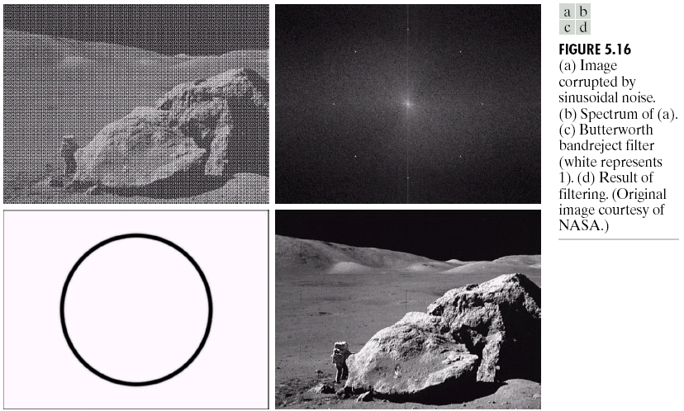
Key Stages in Digital Image Processing:
Image Restoration
Image
Restoration
Morphological Processing
Image
Enhancement
Segmentation
Image
Acquisition
Representation &
Description
Images taken from Gonzalez & Woods, Digital Image Processing (2002)
Object
Recognition
Problem Domain
Color Image Processing
Image
Compression

Slide 29
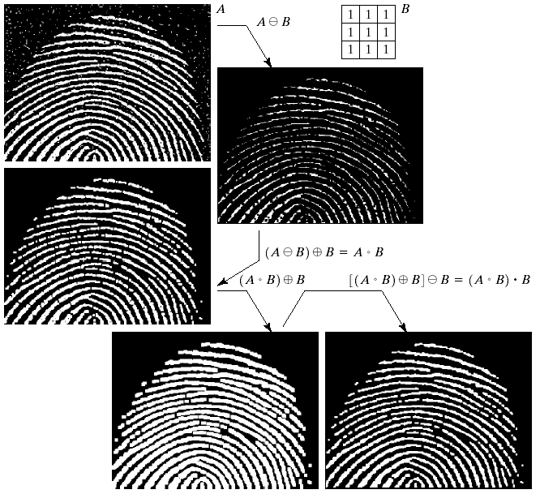
Key Stages in Digital Image Processing:
Morphological Processing
Image
Restoration
Morphological Processing
Image
Enhancement
Segmentation
Image
Acquisition
Object
Recognition
Images taken from Gonzalez & Woods, Digital Image Processing (2002)
Representation &
Description
Problem Domain
Color Image
Processing
Image
Compression

Slide 30
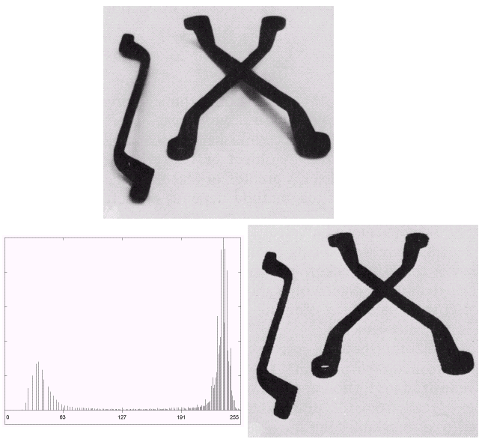
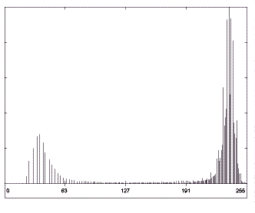
Key Stages in Digital Image Processing:
Segmentation
Image
Restoration
Morphological Processing
Image
Enhancement
Segmentation
Image
Acquisition
Representation &
Description
Images taken from Gonzalez & Woods, Digital Image Processing (2002)
Object
Recognition
Problem Domain
Color Image Processing
Image
Compression

Slide 31
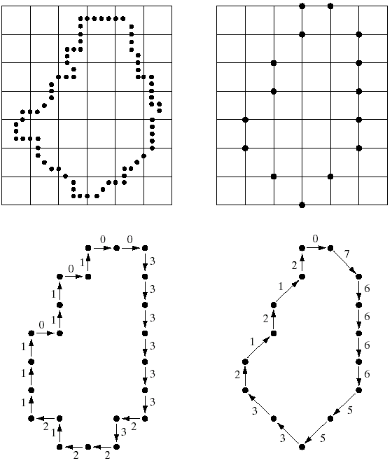
Key Stages in Digital Image Processing:
Representation & Description
Image
Restoration
Morphological Processing
Image
Enhancement
Segmentation
Image
Acquisition
Images taken from Gonzalez & Woods, Digital Image Processing (2002)
Representation & Description
Object
Recognition
Problem Domain
Color Image Processing
Image
Compression

Slide 32
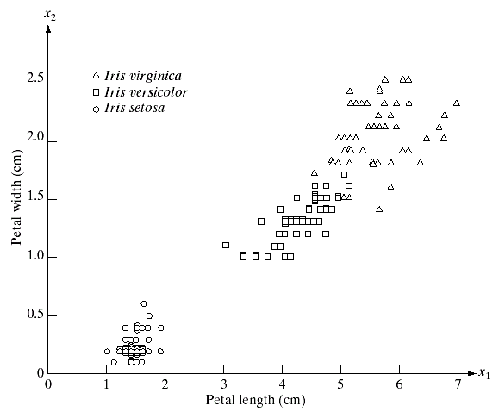
Key Stages in Digital Image Processing:
Object Recognition
Image
Restoration
Morphological Processing
Image
Enhancement
Segmentation
Image
Acquisition
Representation
&
Description
Images taken from Gonzalez & Woods, Digital Image Processing (2002)
Object
Recognition
Problem Domain
Color Image Processing
Image
Compression

Slide 33
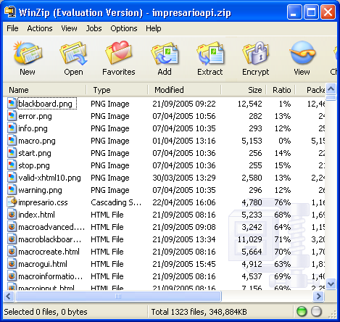
Key Stages in Digital Image Processing:
Image Compression
Image
Restoration
Morphological Processing
Image
Enhancement
Segmentation
Image
Acquisition
Representation &
Description
Object
Recognition
Problem Domain
Color Image Processing
Image
Compression

Slide 34
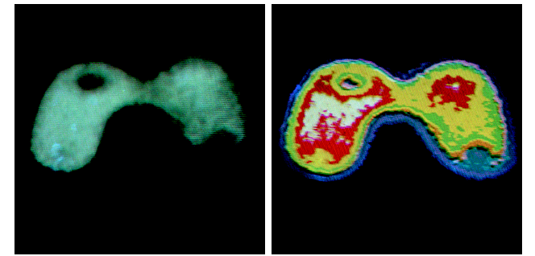
Key Stages in Digital Image Processing:
Colour Image Processing
Image
Restoration
Morphological Processing
Image
Enhancement
Segmentation
Image
Acquisition
Representation &
Description
Images taken from Gonzalez & Woods, Digital Image Processing (2002)
Object
Recognition
Problem Domain
Color Image Processing
Image
Compression

Slide 35
Applications of Image Processing

Slide 36
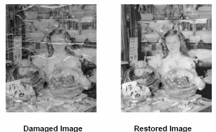
1. Image Restoration

Slide 37




Movie film restoration

Slide 38
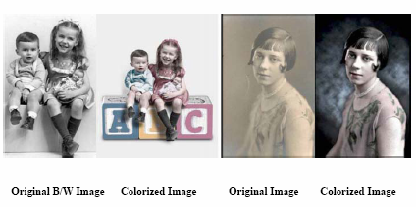
Image Colorization

Slide 39
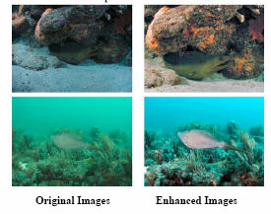
Image Enhancement

Slide 40
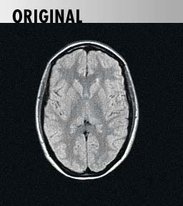
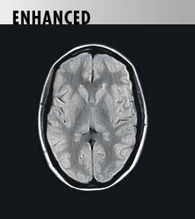
Image enhancement

Slide 41
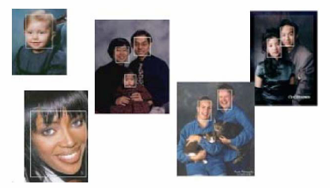
Face Detection

Slide 42
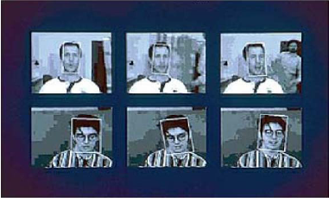
Face Tracking

Slide 43
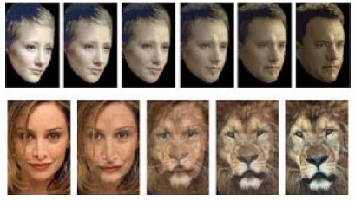
Face Morphing
Notes:
Morphing: the smooth transformation of one image into another by computer.

Slide 44
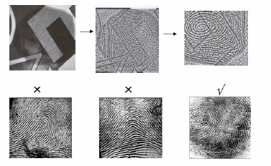
Finger Print Recognition

Slide 45
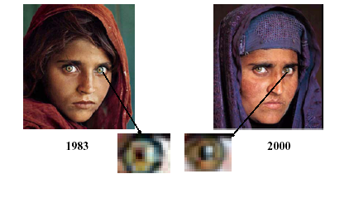
Personal Identification Using Iris Recognition

Slide 46
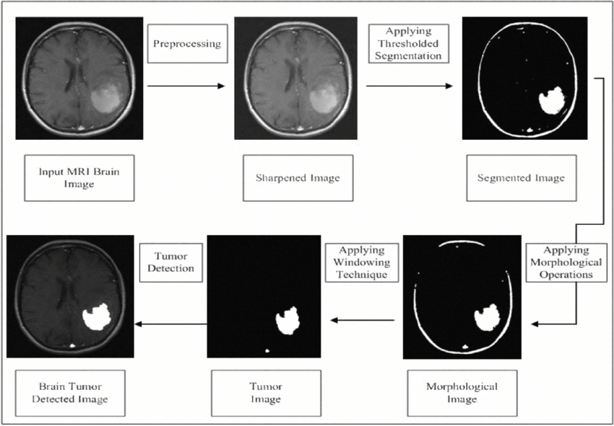
Disease detection (Brain Tumor)

Slide 47
Image Processing Components
Image Sensing device
Storage Media
Processing Systems
Displays
Communication Media
Hardcopy devices (e.g Printer)

Slide 48
Camera
Lens (CMount, CSMount, Motorized)
Optical Filter (Selectivity in EM waves)
Imaging Sensor (CCD Sensor)
Flash (Used for lighting/Illumination)
Front Illumination
Back Illumination
Digitizer
Notes:
Digitizer is a device used for converting the output of the physical sensing device into digital form.

Slide 49
Processing systems
PC based
General purpose PCs
Servers
Industrial PCs
Embedded system based
DSP processor based
FPGA based
System on chip (SoC)

